Slide 1

Network Analysis
ADS-516
Dr. Suat ATAN
Week:4

Slide 2
Lecture plan
Basic Network Plotting and Layout
Design Principles for Visualization
Design Elements
Effective Design

Slide 3
Basic Network Plotting and Layout

Slide 4
An effective and clear network graphic
Convey the critical information:
Overall Structure of network
Location of important nodes
Presence of subgroups (if available)
-Minimize irrelevant information

Slide 5
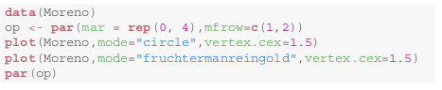
Basic Plotting

Slide 6
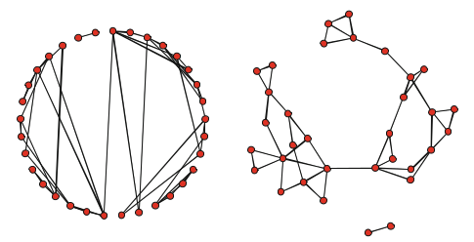
Is both are same?

Slide 7
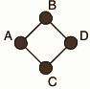
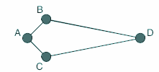
Line length

Slide 8
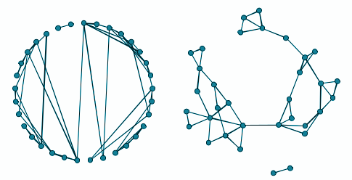
Obscuring information by layout

Slide 9
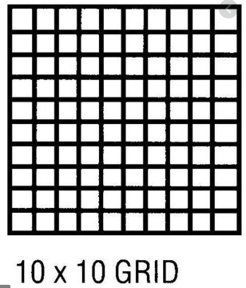
The Aesthetics of Network Layouts
50 Nodes
First node: 1/100 alternative place
Second node: 1/99
alternative place
...

Slide 10
Network Visualization Guidelines
Maximize the symmetry of the layout of nodes.
Minimize edge crossings.
Minimize the variability of the edge lengths.
Maximize the angle between edges when they cross or join nodes.
Minimize the total space used for the network display.
Network Analysis (Luke and Douglas, 2015)

Slide 11
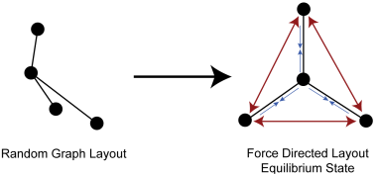
Force-Directed Algorithms

Slide 12
Random Layout
plot(g,layout=layout_randomly(g))

Slide 13
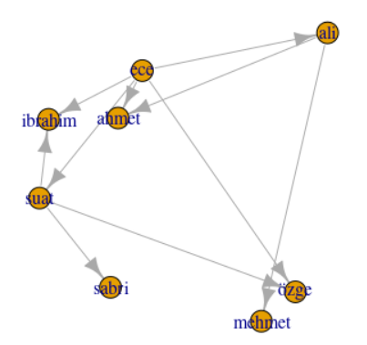
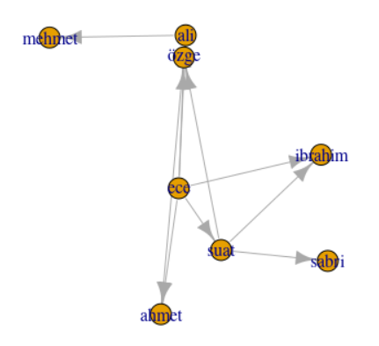
Random Layout

Slide 14
Fruchterman-Reingold Algorithm
Fruchterman and Reingold introduced one of the first force-directed network display algorithms, and it is still very widely used.
plot(g,
layout=layout.fruchterman.reingold(g))

Slide 15
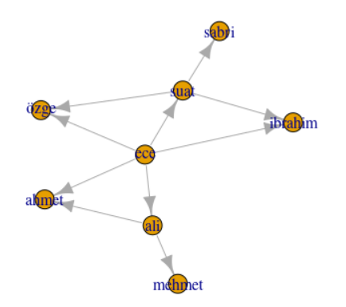
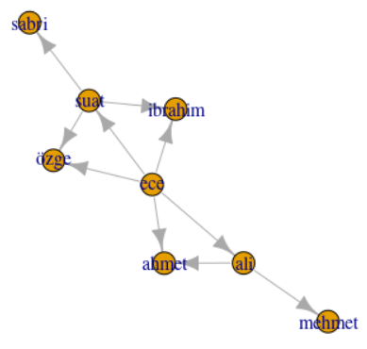
Fruchterman-Reingold Algorithm

Slide 16
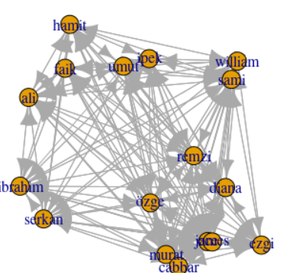
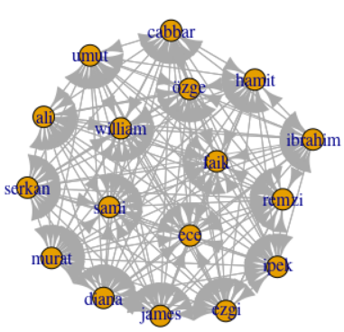
Comparison of layout algorithms on bigger network (03.csv)

Slide 17
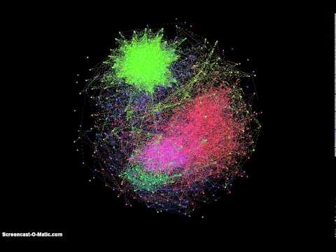
Iterations of Fruchterman Reingold Algorithm

Slide 18
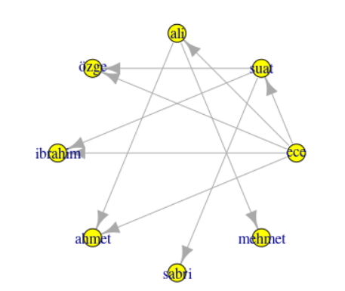
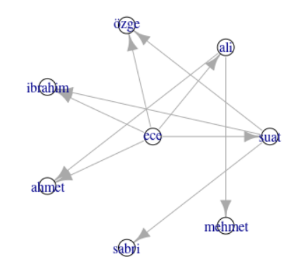

Slide 19
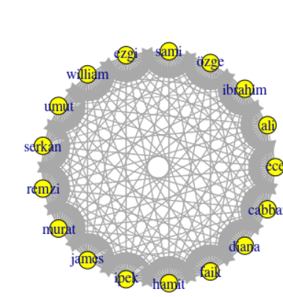
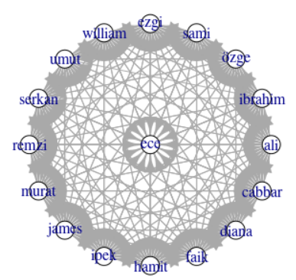
Circle vs. Star

Slide 20
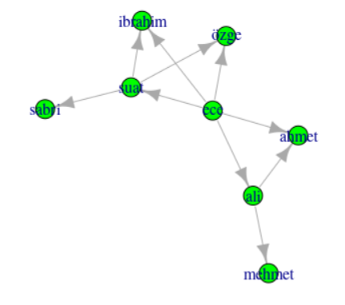
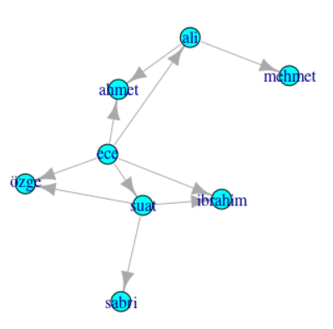
Davidson-Harel vs. DRL

Slide 21
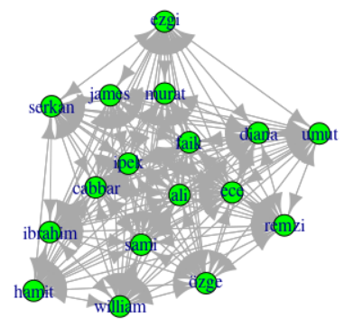
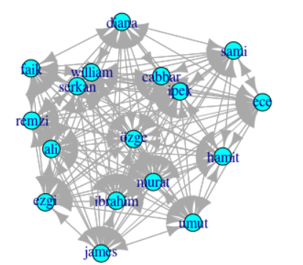
Davidson-Harel vs. DRL

Slide 22
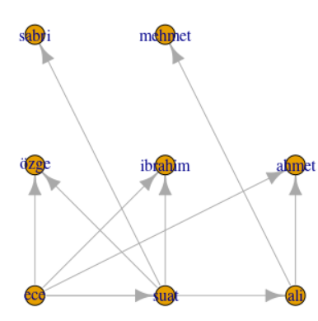
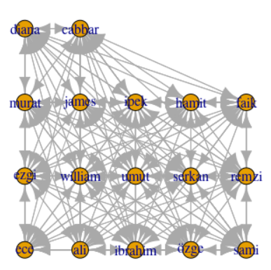
Grid Layout

Slide 23
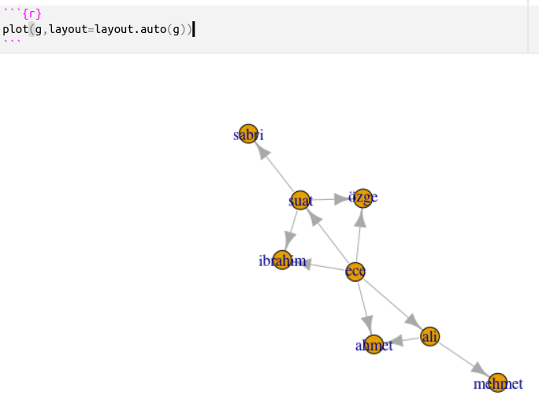
Layout Auto

Slide 24
Design Principles for Visualization

Slide 25
Effective Design for Visualization
“Graphical excellence is that which gives to the viewer the greatest number of ideas in the shortest time with the least ink in the smallest space.”
Edward Tufte - The Visual Display of Quantitative Information
However, ideas shout be about data not about your skills or intelligence or about “newfangled” tool.

Slide 26
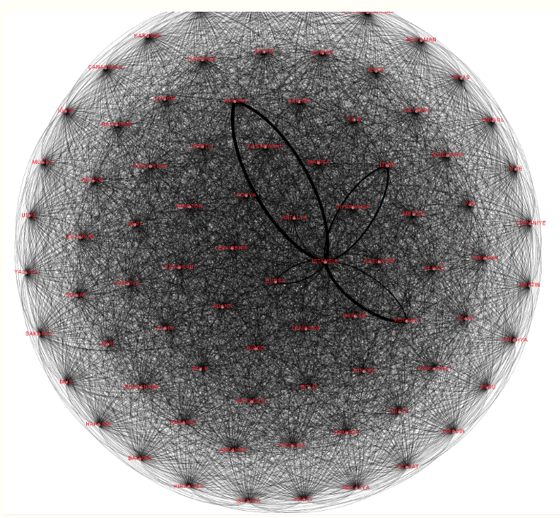
An Example 1
https://rpubs.com/suatatan/tiata-2017

Slide 27
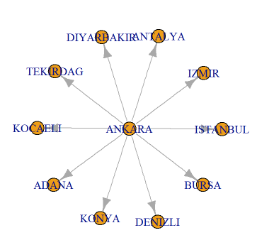
An Example 2
https://rpubs.com/suatatan/tiata-2017

Slide 28
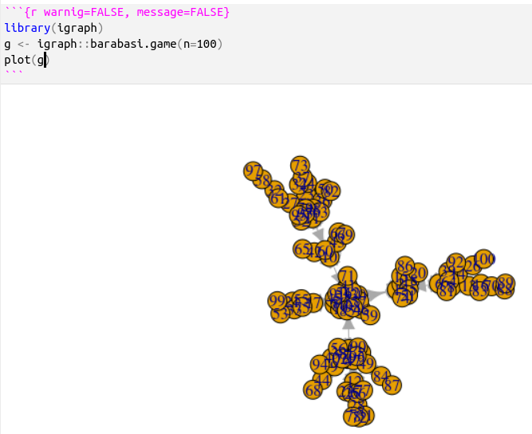
Direct Plot and Poor Design
Focus on:
Tangled nodes
Wrong size
Wrong color
Unreadable labels
Wrong position
Wrong color
Wrong size
Indiscernible arrows
Wrong arrow size
Layout
Could be better

Slide 29
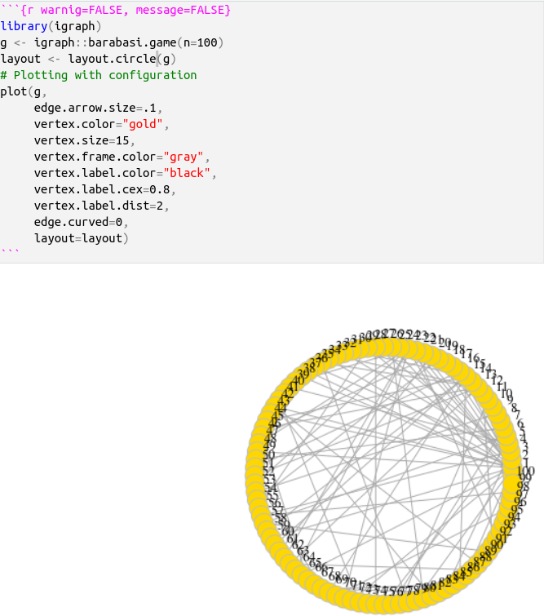
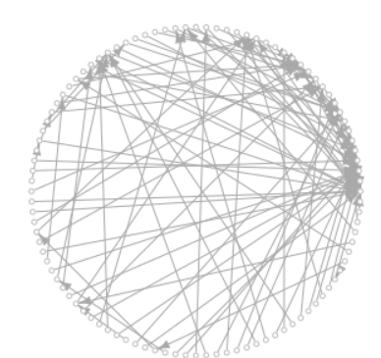
Unsuccessfull Stylized Plot Examples

Slide 30
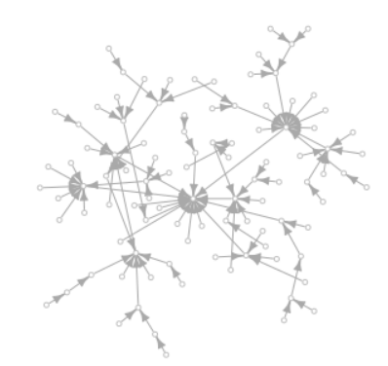
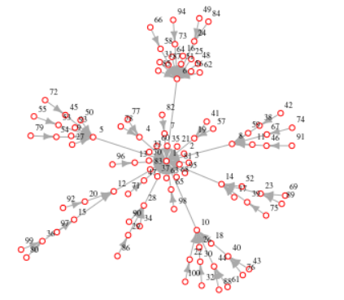
Davidson Harel vs. Auto Layout

Slide 31
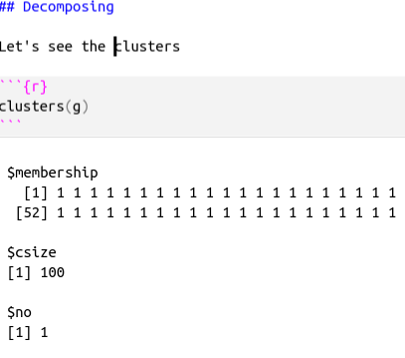
A strategy: decompose to see
For networks includes several submodules we can decompose by decomposing
But we can’t because everything are connected

Slide 32
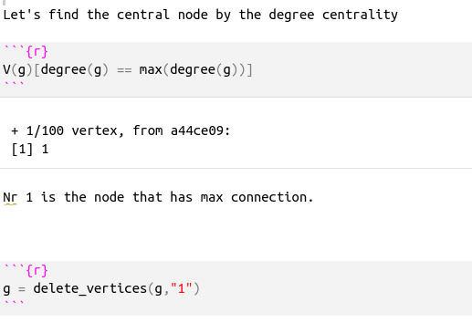
Dethrone the king and behold the courtiers
Find the node that has the most connection
Delete the node that has the most connection

Slide 33
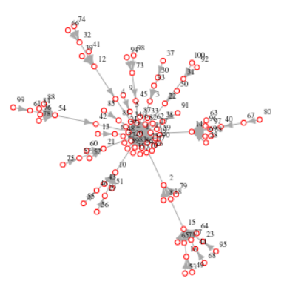
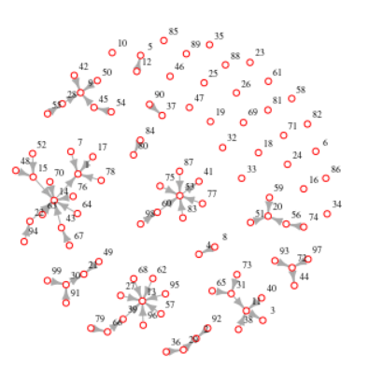
Effect of dethroning the king
Loyal servants of the king
King
A community (subgroup)

Slide 34
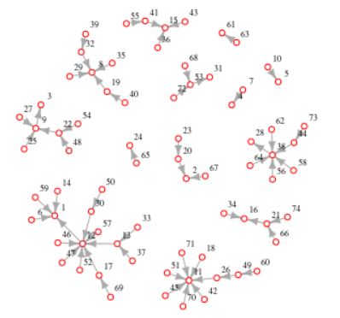
Get rid of the loyal servants of the deposed king
Isolated = which(degree(g)==0)
g_post_king = delete.vertices(g, Isolated)

Slide 35
More information with the variants

Slide 36
Design Elements

Slide 37
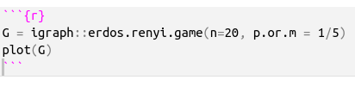
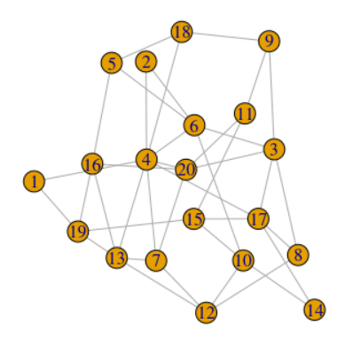
Node color

Slide 38
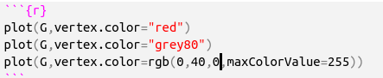
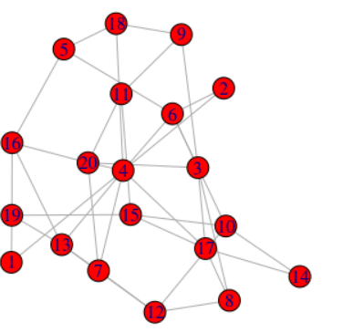
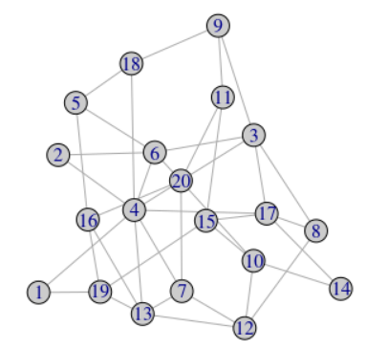
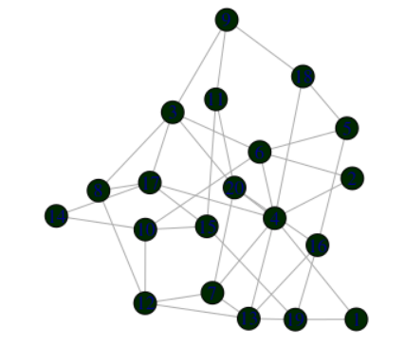
Node Color

Slide 39
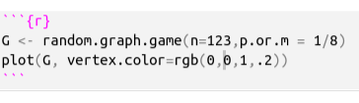
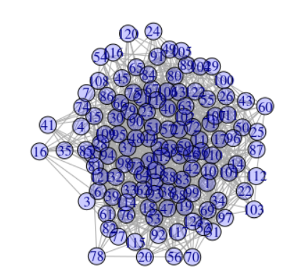
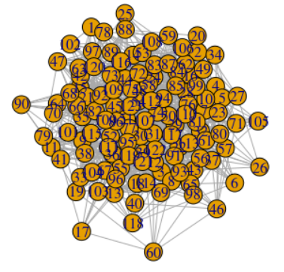
Opacity
1: opaque
0:clear

Slide 40
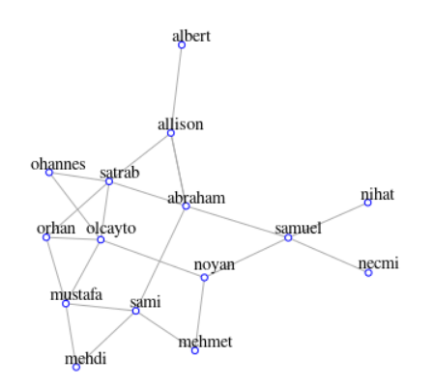
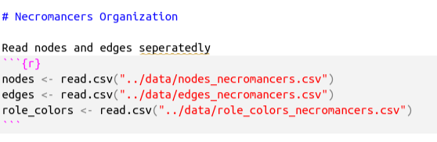
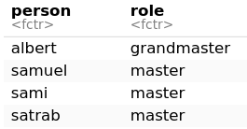
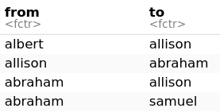

Node Coloring

Slide 41


Assign the attributes to nodes

Slide 42

Show node attributes

Slide 43

Setting the node colors by attributes

Slide 44

Other node attributes
Node size
Default
By degree
Node shape
By attribute
Node label
Big
Small
No label
Distance of label from the node
Node frame color
#to show assigned attributes
list.vertex.attributes(ng)

Slide 45

Plotting parameters
https://kateto.net/netscix2016.html

Slide 46


Plotting parameters
https://kateto.net/netscix2016.html

Slide 47
The End
Dr. Suat ATAN

